Slide 1

MICROSOFT project

Slide 2
UNDERSTANDING OF THE PROBLEM
The problem faced by Microsoft in the creation of a new movie studio is the type of films that are currently doing the best at the box office.

Slide 3

SOLUTION TO THE PROBLEM
The solution to the problem is possible by carrying out Data analysis through EDA pandas.

Slide 4

POINTS OF FOCUS
Profit
Best selling genre and time
Finding best directors and writers to hire

Slide 5
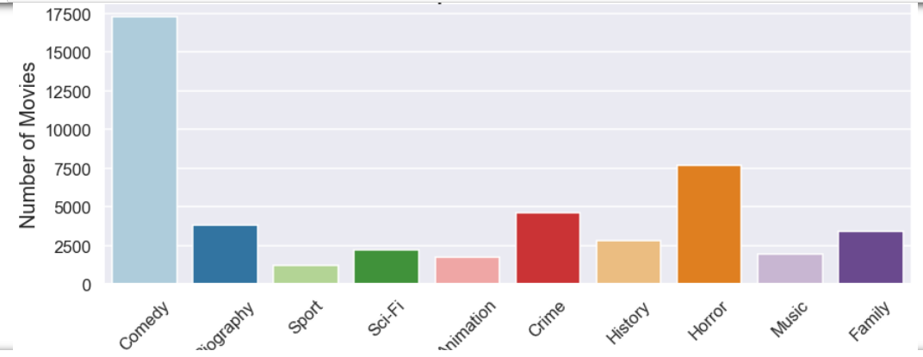
tHis bar graph shows movie genre that is liked by many people,,,,and from the graph it is evident that most people like comedy

Slide 6
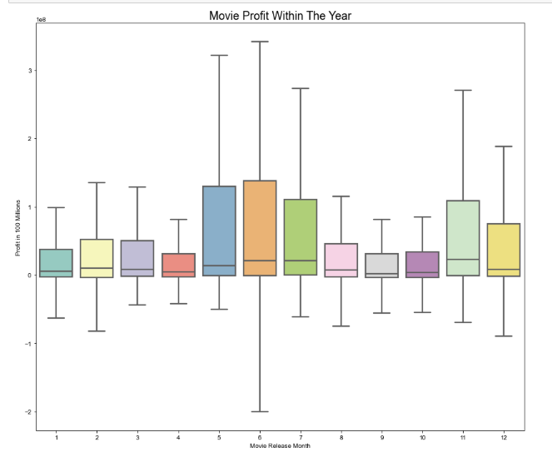
Best months to release movies
The boxplot shows that high profits months are mid year and that is April, may ,June and December as well

Slide 7
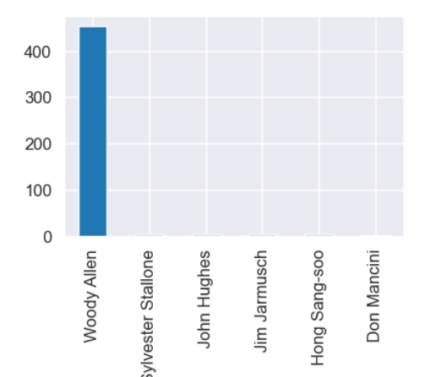
Movie writers counts
The bar graph shows movies writers with their value counts. Woody Allen happens to have
written the highest number of movies.

Slide 8
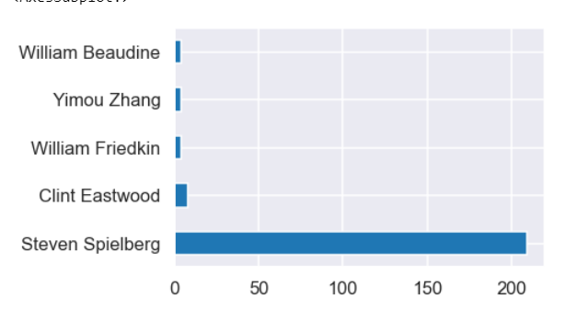
Directors value count
The horizontal bar graph shows the director who has directed many movies and that is Steven Spielberg.

Slide 9
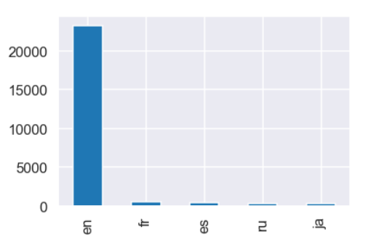
Language counts analysis
The bar graph shows best movie languages liked by most viewers, This shows that most people like to watch movies English movies.

Slide 10
Recommendations based on eda
1.Release comedy movies, horror movies, crime movies and family movies in order for them to gain high profit
2.Release movies in the month of April, may, june and December because to in order to yield high profit, most people are likely to be on holidays watching and enjoying the stated movies genres
3.Hire writers who have written alot of movies because they have got experience.
4.Hire directors who have directed many movies since they have got experience
5.The most liked movie language is English

